Slide 1
Escambia County Public Schools
Health Services Update
2024-2025

Slide 2
Introduction
This module is designed for staff who have previously completed the Initial Health Services Workshop in person.
This module, post-test and check-off of skills by RN fulfills the annual update requirement for staff administering medications.

Slide 3
Steps
ECSD Staff:
Review this module.
Return to Health Services webpage to obtain post test.
Print and complete the test.
Contact school nurse to verify skills and review test results.
Store documentation of delegation in medication administration book .
Charter or Private School Staff:
Follow steps above. You may email or fax the post test to the Health Services Coordinator for a review. You will receive a notice of completion by return email or fax.

Slide 4
OBJECTIVES OF MODULE
Identify health services documentation forms
Review medication policy, procedures and health guidelines
Review established procedures for medication administration and documentation
Notes:
Read slide.

Slide 5
3 Required Health Forms
The Student Health Verification Form
This form is printed from the Student Information System (Focus) and sent home for the parent/guardian to review and update health information and allows for opting in or out of each school health service. The parent/guardian needs to sign the emergency care statement annually.
Immunization Record – Florida DH680
Every student needs a valid Florida DH 680 immunization record. Out-of-state immunization records are not acceptable. Data must be transcribed onto the Florida form. This can be done at a Doctor’s office or the parent/guardian can complete a transfer form and fax it with out-of-state immunization records to the local Department of Health. It will then be transcribed onto the Florida form. This transfer of records form can be found on the Health Services page of the District website https://www.escambiaschools.org/health_services
School Entry Physical –
Must be dated within 1 year of entry into a Florida school. Out of state physicals may be accepted. All physicals are accepted conditionally subject to the review by the school nurse.

Slide 6
Online Forms https://www.escambiaschools.org/health_services
Clinic Forms – These are forms for day to day management in the clinic. No password is required.
Secure Health Forms -Health care providers can contact Health Services Office at 850-469-5456 for secure forms.
Medication Administration Authorization-
  Dispersion of Medication Form
  Rules and Procedures of the District School Board Escambia County, Florida School Operations
  Medication Policy 3.07(18)
  Medical Marijuana Policy 3.07(19)
  Both Policies can be found at: https://www.escambiaschools.org/health_services

Slide 7
Medication Administration Procedures
A Dispersion of Medication Form (9400-HES-005A) must be completed for each prescription/non-prescription medication provided by the parent/guardian. Parent/guardian’s signature must be witnessed by school district or clinic staff, or be notarized.
If students are to carry and/or self-administer prescription medication* at school or school activities, the Dispersion of Medication Form must be also signed by their healthcare provider.
  *This is limited to inhalers, epinephrine auto-injectors, pancreatic enzymes and diabetes supplies and medication.
  Students may possess and self-administer FDA regulated over-the-counter medication for headaches as permitted by Section 1002.20(3)(p) F.S.

Slide 8
Remember:
Administration of medication is the responsibility of the parent/guardian unless it is absolutely essential to the well being of the student to receive medication during the school day. The following regulations must be observed when any medication (prescription/ non-prescription) is to be administered in the school. This includes any occasion when the student is away from school property on official school business, i.e., band, field trips, sports and extracurricular activities.

Slide 9
Medications which may be administered by medical or trained non-medical school personnel include the following: oral and topical medications, eye, ear, and nose drops, and inhalers. Volunteers may not administer medication to students.
Administration of other types of FDA regulated medications are evaluated on an individual basis, require child specific training, and appropriate delegation as determined by the professional school nurse (RN). All delegation must be in accordance with Florida Nurse Practice Act, Chapter 464.
Notes:
Read slide.

Slide 10
Receipt of Medication
Medications must be delivered to the school by parent/guardian or other responsible adult.
All medications must be counted and documented on a student medication record with parent/guardian or their designee upon receipt and return of medication.
Check expiration date of inhalers on the bottom of the canister, Epinephrine on the side of the auto-injector, and Diastat on the syringe, not only the date on the pharmacy label on the box.
Oral medications from a pharmacy are good for one year after they are dispensed. This date is on the pharmacy label.
Document medication expiration date on Student Medication Record.
Flag all new authorizations for school nurse to review and sign

Slide 11
Steps For Administering Medications
First, wash your hands, then:
Identify student, open medication book
Verify student’s name with authorization form and medication label. Do not offer the student’s name. They must identify themselves. If they are unwilling or unable (special needs) to say their name, then an adult must identify them. Always use 2 identifiers such as name and: date of birth, color of pill, student number, etc.
Always confirm: Right Student, Right Medicine, Right Dose, Right Time, Right Route, Right Documentation, Right Expiration Date and student has the Right to Refuse*
Administer medication and recheck the 8 rights
Document on Student Medication Record
*Make every effort to administer medication as it is ordered. If student refuses to take medication, contact a parent as soon as possible.
Right Medicine
Right Dose
Right Time
Right Student
Right Route
Right Documentation
Right Expiration
Right to Refuse

Slide 12
When can a routine (scheduled) medication be administered?
Approved window for administration at school is 1 hr before until 1 hr after prescribed time (2 hr window of time)
Exception: Medications that must be given at meal times (i.e. Reglan 30 minutes before meals)
Use tick sheet to prevent missed doses. Use of tick sheet is NOT optional.
Any medication given outside of the 2 hour window is a medication error.

Slide 13
Student Medication Record (SMR)
An SMR must be initiated for each student’s medication. This is kept in the medication book.
Clinic staff will store completed/outdated SMRs by scanning and attaching in the student’s Medical Tab in Focus Student Information System and then filing it in student’s Cumulative School Health Record or storing it in the clinic forms box in a secure location.
To transfer students within the District, scan and attach SMR and Dispersion of Medication Form in student’s Medical tab in Focus and them place SMR and Dispersion of Medication Form in student’s Cumulative Health Record Folder and send to receiving school.
Current SMR templates are available in the clinic forms folder online at: https://www.escambiaschools.org/health_services
Notes:
Read slide.

Slide 14
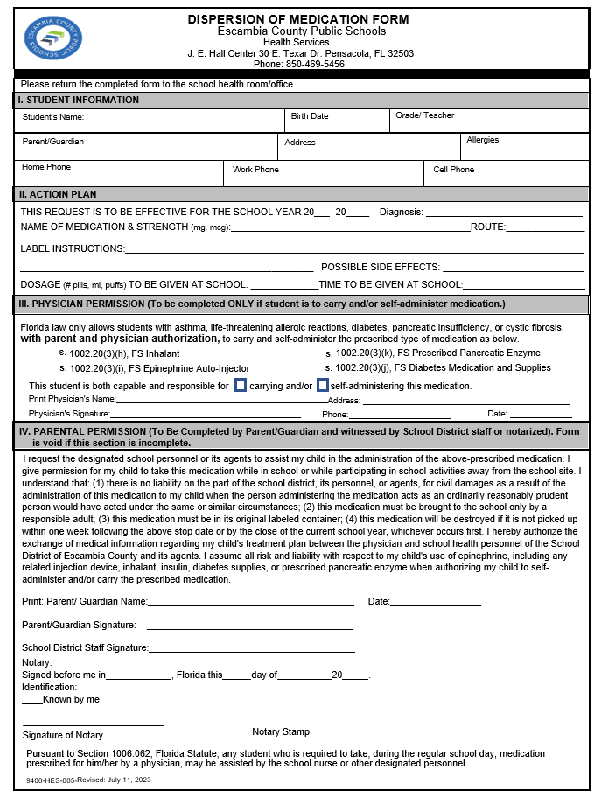
Dispersion of Medication Form
The current form is dated July 11, 2023 and is available in school clinics and on the District website: https://www.escambiaschools.org/health_services
Maintain properly signed Dispersion of Medication Form in the Medication Administration Book.
Notes:
Last sentence under parental permission is legal reminder to parent.

Slide 15
Record Keeping & Reporting
Each school is required to maintain a medication book. You may separate scheduled medications from PRN medications.
Medication book contains:
  Alpha Index
  Dispersion of Medication Form on the left, the Student Medication Record (SMR) facing it on the right
  Medication Training Acknowledgement and Competency Checklist Form
  School Medical Emergency Information Form
  Copies of CPR/First Aid provider cards
  Medication Destruction Worksheet
  Medication Error/Event Form
Notes:
Read slide.

Slide 16
Errors happen when the
8 Rights are not verified
Right student?
Right medication?
Right dose?
Right time?
Right route (by mouth, injection, etc)?
Right documentation?
Right expiration date?
Student has right to refuse. (Do not offer this an option, but do not force a student to take medication. Contact parent if student refuses medication).
Administer the medication only after you have verified all questions. You cannot safely administer medications without opening the medication book to view the authorizations –
EVERY STUDENT, EVERY DOSE!

Slide 17
Help prevent wrong dose
Messages from parents regarding medication changes should be delivered directly to the clinic staff.
If message is received by other personnel, it must be immediately reported to the clinic staff.
Notes:
Read slide.

Slide 18
Documenting Medication Errors
If a medication error occurs, complete a Medication Error form (blank forms are kept in the medication book or are available on the Health Services page of the District website) and submit within 24 hours to Health Services Coordinator (fax 850-469-5346).
Medication errors and adverse reactions must be documented on Student Treatment Record by health staff. District staff use the Daily Visit Log in Focus Student Information System.
Alert: Notify principal, school nurse, parent (and physician if indicated) of error or event.

Slide 19
Responding to Medication Emergencies
Never leave student alone.
Notify parent and principal immediately, and school nurse if available.
Initiate 911 call, if indicated.
If student is sent to emergency room, send a copy of student’s emergency contact information.
Document on SMR comment section on back of page - Health staff will document in Daily Visit Log of Focus.
Notes:
Read slide.

Slide 20
Emergency Evacuation Plan
Review Emergency Evacuation Plan with School Nurse/Principal to identify your role.
Take emergency medication and medication book when evacuated.
Plan is to be posted in the front office and clinic

Slide 21
Documenting Medical Events
If a serious medical event occurs, particularly if 911 is called, contact the District Health Services Coordinator at 850-469-5456.
Then, complete a Medical Event Form (blank forms kept in the medication book or are available on the Health Services page of the District website) and fax it to the District Health Services Coordinator at 850-469-5346.

Slide 22
Disposal of Medication
Discontinued medication are to be picked up by parent/guardian or designated adult within one week of the stop date.
Notify parent/guardian to pick up medication by the last day of school year. Make every effort to contact the parent prior to destruction of medication.
Medication can no longer be disposed of at District school sites (other than metered dose inhalers). If there are discontinued medications that are not picked up by a parent, or are dropped on the floor, place them in a clear bag with the student name, medication name and keep it locked up in a “quarantine” location until the time to dispose of medication at the end of the school year.

Slide 23
Disposal of Medication
School Nurses will be provided with a container to collect non-controlled medications. This container will be delivered to the District Health Services office to be sent for disposal as biohazardous medical waste through a vendor. Controlled medication will counted at the school by 2 staff members and then be delivered to the District Health Services office to be disposed of at a local pharmacy.
Private and Charter Schools should contact a local pharmacy to determine where they can dispose of expired or discontinued medication that parents will not pick up from the school.

Slide 24
Responsibilities Regarding Medication and Medical Diagnosis
School Personnel Do Not:
Suggest or diagnose any health condition.
Recommend a specific health care provider.
Recommend medication or treatment.
Exclude any student for not having medication.
Contact medical provider to recommend diagnosis or treatment for student.
School Personnel Do: refer student health information and issues to the school nurse.
Notes:
Read slide.

Slide 25
Other Responsibilities Regarding Medication Administration
Do not use white out for corrections:
  Draw line through error and initial above the line.
  Make correct entry.
Keep medication cabinet and key secured:
  Medication carts or cabinets must be locked unless staff is retrieving medication. If you leave the room, or leave sight of medication cart or cabinet, it must be locked. Locking the clinic door is not sufficient.
  Each school must have a plan for managing key security during the school day and after hours. Clinic staff do not take medication cart keys home after school hours.
Refer health questions to school nurse.

Slide 26
Confidentiality
In the course of caring for a student, information of a private or personal nature may be divulged.
It is imperative that you keep in confidence such information; this is an ethical and legal standard that must be upheld.
Before sharing any information with any staff member, stop and ask yourself, “Does this person have a legitimate educational need to know?”
Do not discuss students’ health information with others who are not directly involved in care.
Student’s HIV status is never documented or shared.
Notes:
Read slide.

Slide 27
Medication Audits
These are to be performed throughout the year by the school nurse to monitor administration of medications and identify procedural problems.
A minimum of one audit per semester is required.
Prescription medications on hand are counted during audit and counts reconciled.
Scheduled medications are counted at the start of each month and the total is listed in the Medication Count section. This only requires one signature.

Slide 28
Common Issues
Do not administer any medication without a signed authorization (Dispersion of Medication Form). A verbal request is not acceptable.
Do not accept parent’s request to alter physician’s order; a new pharmacy labeled container must be provided. Parent always has option to come to school and administer medication.
Do not assume a student has an authorization, always look at the authorization prior to administering medication.
Do not administer non-FDA regulated medications or products (ie. essential oils, medication from another country etc.) If in doubt, contact your school nurse. You need to know what you are administering and its possible side effects.

Slide 29
Field Trip Procedures
District staff must submit a completed “REQUEST FOR NURSING SERVICES ON FIELD TRIP/COMMUNITY-BASED INSTRUCTION TRIPS” form to the Health Services Coordinator for students who need health assistance on a field trip (fax # 850-469-5346).
Notify School Clinic Staff of all planned field trips as soon as possible (see District Activity Trip/Off Campus Activity Request Form located on the Transportation page of the District website).
All medication administration policies and procedures must be followed during field trips and extra-curricular activities.

Slide 30

Infection Control Guidelines
Handwashing is the best defense against infection for you and the student.
  Use anti-bacterial soap.
  Use hand sanitizer only if soap and water is not available.
Change cot paper between students.
Clean frequently touched surfaces and cots with Sanizide plus spray or other approved disinfectant (available in the District warehouse).
Do not use bleach as it may stain clothing/shoes and may be inadvertently mixed with ammonia cleaning products.
Clinic is to be cleaned daily by custodial staff – trash should be removed daily and as needed.
Notes:
Items available through Central Warehouse.

Slide 31
Universal Precautions
Treat ALL blood and other body fluids as potentially infectious.
Maintain disposable plastic Sharps Container.
Clean surfaces with Anti-TB Sanizide Plus, GE Fight Bac, or other District approved disinfectant (available from the Warehouse).
Wear gloves whenever handling body fluids.
Use appropriate Personal Protection Equipment.
Wash hands after removing gloves.
If it is wet, and not yours, don’t touch it without gloves.
Notes:
Read slide.

Slide 32
Sharps Container Disposal
Seal and date container when ¾ full of sharps.
School Health personnel will contact school health vendor to dispose of sharps container.
If anything that is not a sharp (such as blood saturated material) is placed in container:
    Date container and start 30 day clock.
    Seal container on 30th day.
    Contact Nurse to arrange transport of sharps container for disposal.
Notes:
Read slide.

Slide 33
Medical Guidelines
Guidelines for managing Severe Allergies, Asthma, Diabetes, or Seizure Disorders are found on the District website Health Services page: https://www.escambiaschools.org/Page/1054

Slide 34
Medication Related Emergencies
An allergic reaction to a medication can occur at any time, no matter how long the student has been taking medication.
Allergic symptoms:
  Rash
  Swelling and Itching
  Breathing problems
  Bluish color of skin
  Increasing anxiety

Slide 35
Anaphylaxis
Medical term for life-threatening systemic allergic reaction that may occur when allergic individuals are exposed to specific allergens. Anaphylaxis is a collection of symptoms affecting multiple systems in the body.
Epinephrine (adrenaline): single most important medication for treating anaphylactic reactions; should be administered at the first sign of a systemic allergic reaction. If epinephrine is given, call 911, notify the Principal and parent.

Slide 36
Anaphylaxis Signs & Symptoms
Hives, itching (of any body part);
Flushed, pale skin, dizziness;
Swelling (of any body part);
Red, watery eyes, runny nose;
Fainting, or loss of consciousness;
Wheezing, coughing, difficulty breathing; shortness of breath;
Change in mental status; increasing anxiety
Throat tightness or closing; difficulty swallowing.
Nausea, vomiting, abdominal pain
Notes:
Read slide.

Slide 37
Asthma
Students often have orders to administer an inhaler before P.E. or recess.
If a student states they need their inhaler, and it is in the clinic with proper authorization, allow student to use it. Notify parent. Do not withhold an inhaler because of lack of a cough or lack of obvious difficulty breathing.

Slide 38
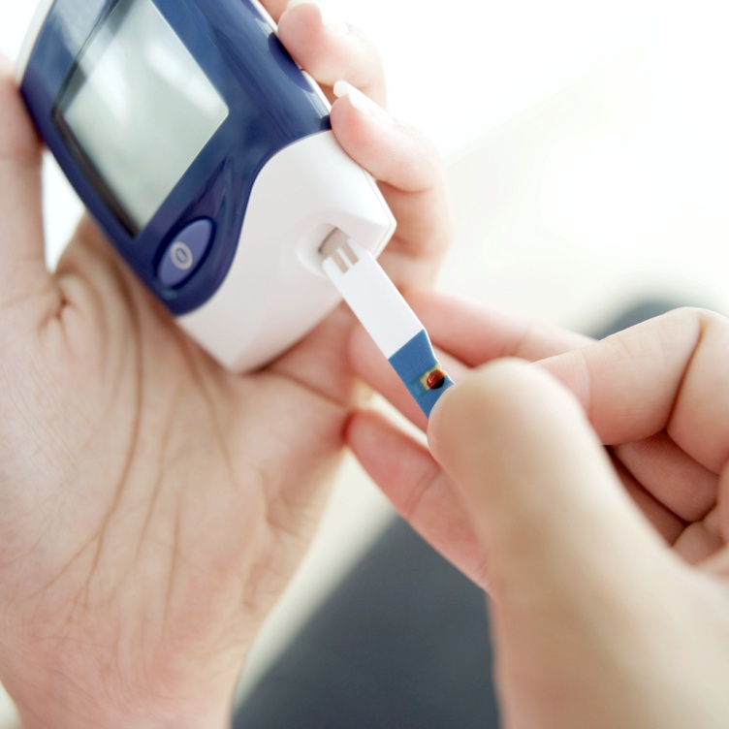
DIABETES
ALWAYS notify your school nurse of a new student with diabetes.
Child-specific training is required before you can provide care for a student with diabetes.

Slide 39
Seizure Management
Review the First-Aid Flow Sheet for Seizure Management located in the ECPS Health Services Policy and Procedure Book.
Child-specific training must be provided by the school nurse if a Vagal Nerve Stimulator or emergency seizure medication is authorized.
If a parent provides an individual seizure action plan signed by the Dr., staff who have routine contact with the student are required to complete epilepsy training. The school nurse will facilitate this training.
Private/Charter school staff may find training at Epilepsyalliancefl.org

Slide 40
Call 911:
If seizure lasts longer than 5 minutes or as directed in student’s health care plan/seizure management plan.
If student has repeated seizures.
If student has trouble breathing after a seizure.
If student cannot be aroused after a seizure.
If student is pregnant, diabetic, or has no known history of seizures.
If emergency seizure medication is administered.
If student has a diagnosed seizure disorder, it is not necessary to call 911 automatically if they have a seizure.
Notes:
When in doubt...call 911.

Slide 41
COVID-19
The public health emergency for the emergence of the novel virus, SARS-CoV-2 (COVID-19) that was placed by the U.S. Department of Health and Human Services expired on May 11, 2023. Although COVID-19 no longer poses the societal emergency that it did when it first emerged in late 2019, COVID-19 remains an ongoing public health challenge.
Community transmission level and COVID-19 community-level metrics were discontinued on May 11, 2023. Tracking of COVID-19 cases is continuing at the hospital admissions level. Quarantine is no longer recommended for people who are exposed to COVID-19 except in certain high-risk congregate settings such as correctional facilities, homeless shelters, and nursing homes.
Clinic staff will assess and treat students who exhibit any respiratory symptoms.

Slide 42
Head Lice Management
Only exclude students who have live bugs or nits less than ¼” from the scalp on initial examination that have not been already treated.
Students may return to school after being treated with a lice killing product and no live lice are found by school/clinic staff.
Nit removal is highly recommended, but not required.
Students are allowed one day of excused absence for the treatment of head lice.

Slide 43
Final Reminders
There are no short cuts to medication administration – ALWAYS check the 8 rights. Always open the medication administration book before administering medication.
All health services forms are available online.
It takes team work between the nurse, health technician, school staff, parent, and student to provide high quality and safe health services.
Be sure to assist the clinic staff frequently so you remain competent and comfortable with administering medications to students. Be familiar with the students listed on the tick sheet.
Notes:
Read slide.

Slide 44
Final Steps
√
Return to Health Services web page to obtain post test: https://www.escambiaschools.org/Page/5184.
Print out the test and complete.
Contact school nurse to review test results, verify skills, and complete competency checklist.
Charter and Private schools fax a copy of completed test to Health Services Coordinator at 850-469-5346 or email it to mhanna@ecsdfl.us. A certificate will be sent via email or fax.
Store documentation in Medication Administration notebook.

